Slide 1
Mold Prevention System
Internet of Things
05.02.2025
by:
Jonas Ohmaescher

Slide 2
Contents 1. Introduction 2. Analysis 3. Design 4. Prototype 5. Conclusion

Slide 3
1. Introduction
Goals of the Project
Develop an IoT system
Monitor environmental data
Supports the user to create a good living environment
Prevent Mold
crucial in houses with bad ventilation or during cold seasons
How does Mold develop?
High indoor humidity (>60%)
creates moisture
Poor ventilation
Warmth

Slide 4
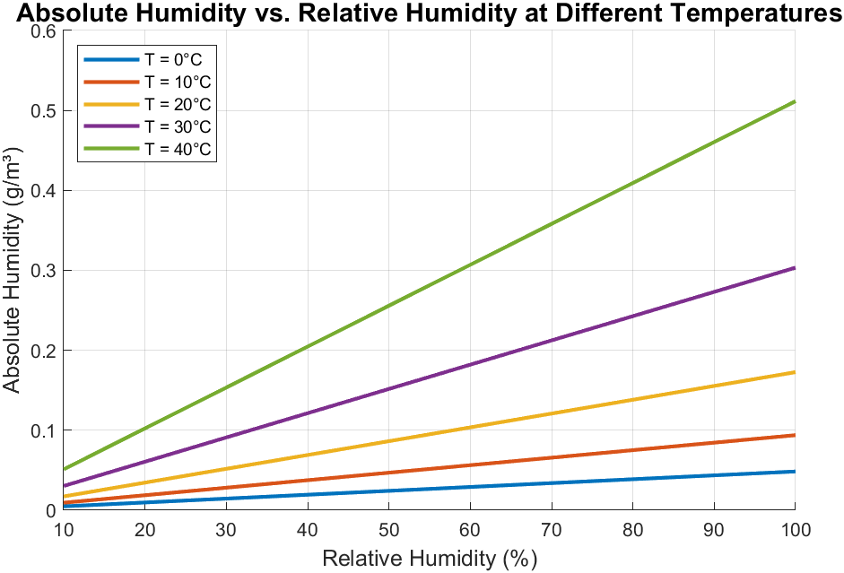

1. Introduction
Relative Humidity vs. Absolute Humidity
Relative Humidity:
Descibes how humid the air feels
Absolute Humidity:
Amount of Water per cubic meter
$$AH= \frac{6.11∗e^{\frac{17.67∗T}{243.5+T}}∗RH∗2.1674}{273.15+T}$$

Slide 5
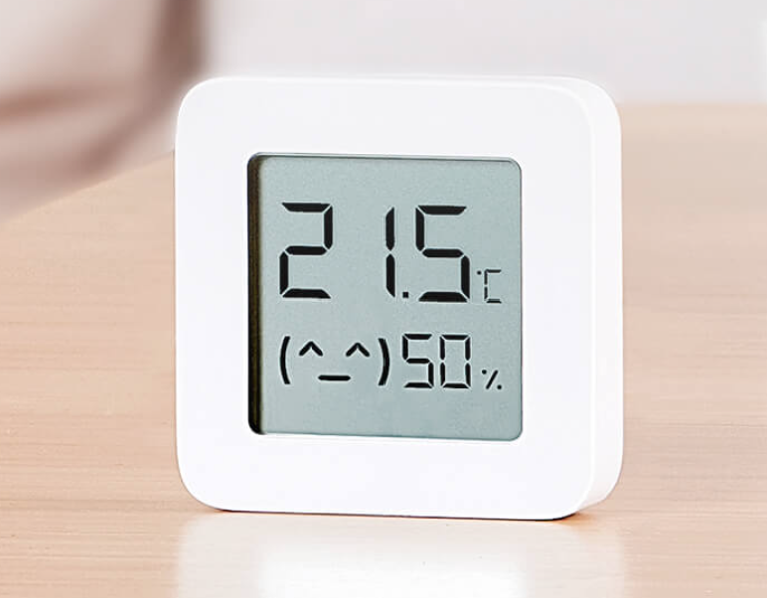
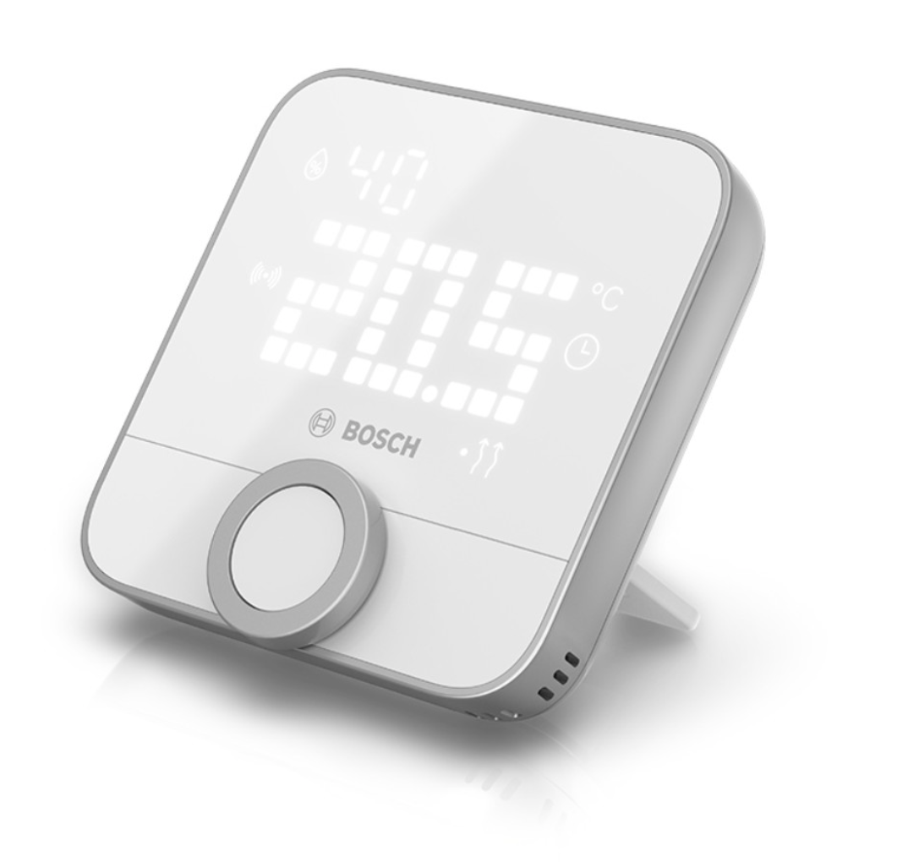
2. Analysis
Competitors
Mi Temperature and Humidity Monitor 2
made by Xiaomi
offers Bluetooth connection
also to other devices (Heating, etc…)
Smart Home Hub 2 for User Notification
Room thermostat II
made by Bosch Smart Home
works similar to the one made by Xiaomi
devices have Bluetooth connection
Controller offers access trough the internet
Costs: 10€
+ 35€ for Ground Station
Costs: 80€
+ 100€ for Controller

Slide 6
2. Analysis
Functional Requirements
ID | Requirement | Input | Output
FR1 | Indoor Temperature and Humidity Monitoring | Current room temperature and humidity | System status update
FR2 | Outdoor Temperature and Humidity Monitoring | Current outdoor temperature and humidity at a specific location | System status update
FR3 | Absolute Humidity Calculation | Temperature and Relative Humidity | System status update
FR4 | Compare Indoor and Outdoor Absolute Humidity | Absolute Humidity | System status update, Flag
FR5 | User Notification to recommend when the window should be opened | Absolute Humidity Comparison | Notification to the user
FR6 | User Warning for high indoor Relative Humidity | Indoor Relative Humidity | Alert notification to the user
FR7 | Update Sensor Configuration | Sensor Configuration Data | Updated System
FR8 | Update Thresholds | User Input | Updated System
FR9 | User Registration | User data | Registered User
FR10 | House Registration | House data | Updated System
FR11 | Remote Window Opening | User command | Window opened, or ventilation system started

Slide 7
2. Analysis
Non-Functional Requirements
NFR1 - Cost-Effectiveness The system must be affordable to ensure accessibility for a broad range of users.
NFR2 - Energy Efficiency Sensors must operate with low power consumption to ensure extended battery life. Data transmission must be optimized to reduce energy usage.
NFR3 – Real Time Notifications The system must send real-time notifications to users about updates or issues, ensuring timely actions.
NFR4 - Environmental Conditions Indoor sensors must operate reliably within 0°C to 50°C and 10%-90% Humidity. Outdoor sensors must operate reliably within -20°C to 50°C and 0%-100% Humidity. Outdoor sensors must withstand environmental conditions such as rain, frost, and heat.

Slide 8
2. Analysis
Hardware Choices
Temperature and Humidity Sensor
DHT11
cheapest one
measuring range doesn´t fulfill outdoor requirements
DHT22
Fulfill requirements
good accuracy

Slide 9
2. Analysis
Hardware Choices
Boards
NodeMCU is chosen
cheapest one
fulfills the requirements
offers all the needed connectivity

Slide 10
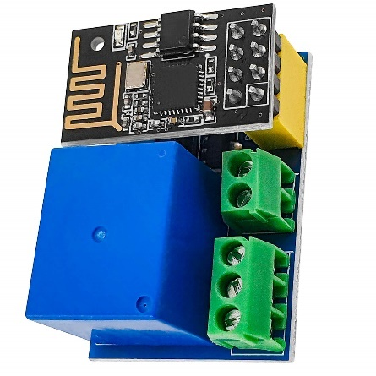
2. Analysis
Hardware Choices
Remote Window Opening
NodeMCU Relay Module is chosen
Actuators could be connected to the Relay

Slide 11
2. Analysis
Communication
MQTT is selected

Slide 12
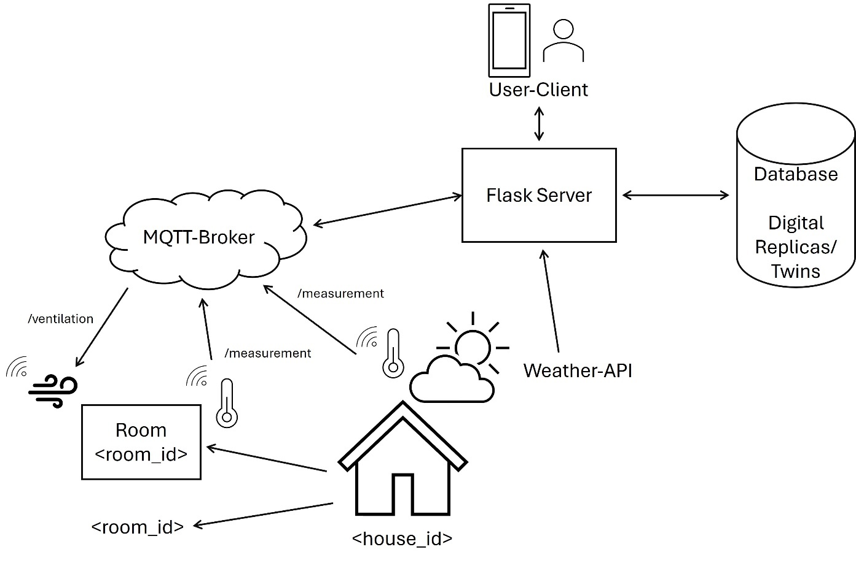
3. Design
Overview

Slide 13
3. Design
Overview
├── Application Layer (Interface & APIs)
│
├── Digital Twin Layer (Core Logic)
│
├── Services Layer (Business Logic)
│
└── Virtualization Layer (Digital Replicas)

Slide 14
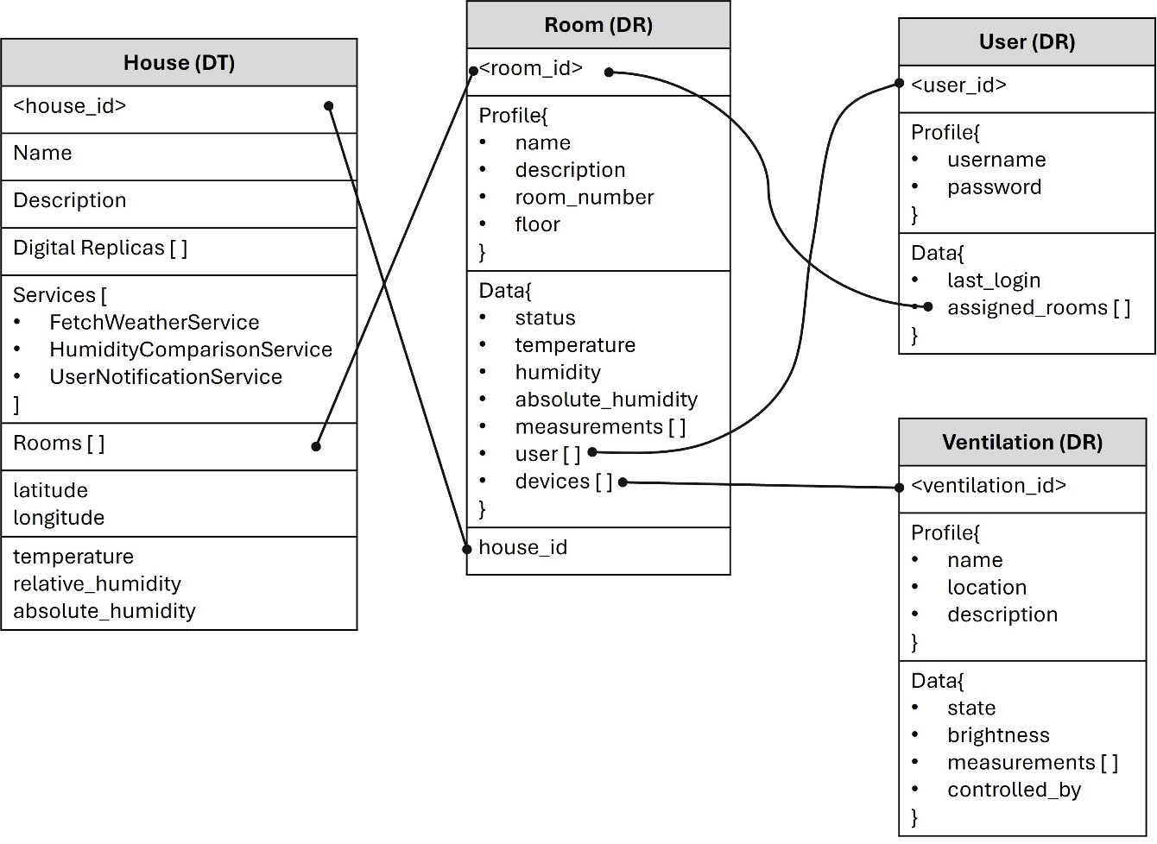
3. Design
Virtualization Layer

Slide 15
3. Design
Services Layer
Fetch Weather Service
Open-Meteo
open source weather API
free and easy to use
Input: Longitude and Latitude
returns current temperature and humidity
Humidity Comparison Service
compares Absolute Humidity
Room
House
returns Absolute Humidity difference
User Notification Service
sends a notification to a logged user trough telegram
Input is the user_id and the text message

Slide 16
3. Design
Digital Twin Layer
HouseFactory(DTFactory)
HouseTwin(DigitalTwin)
Function Name | Description
add_longitude | Adds longitude attribute
add_latitude | Adds latitude attribute
add_temperature | Adds temperature attribute
add_relative_humidity | Adds relative humidity attribute
calculate_absolute _humidity | Calculates and sets absolute humidity based on temperature and relative humidity
add_rooms | Adds rooms attribute
Function Name | Description
add_room | Adds a Room reference to a Digital Twin
remove_room | Removes a Room reference from a Digital Twin
update_temperature_humidity | Updates temperature and humidity values for a Digital Twin.

Slide 17
3. Design
Function name | Route | HTTP Method | Description
create_house | /api/house/ | POST | Creates a new house digital replica.
get_house | /api/house/<house_id> | GET | Retrieves details of a specific house.
list_houses | /api/house/ | GET | Lists all houses with optional filtering.
create_room | /api/house/<house_id> /rooms | POST | Creates a new room within connected to a house.
get_room | /api/house/<house_id> /rooms/<room_id> | GET | Retrieves details of a specific room.
create_device | /api/ventilation/ | POST | Creates a new ventilation digital replica.
get_device | /api/ventilation /<ventilation_id> | GET | Retrieves details of a specific ventilation device.
list_devices | /api/ventilation/ | GET | Lists all ventilation devices with optional filtering.
toggle_ventilation | /api/ventilation /<ventilation_id>/toggle | POST | Toggles the state of a specific ventilation device between on and off.
create_device | /api/ventilation/ | POST | Creates a new ventilation digital replica.
register_user | /api/user/register | POST | Registers a new user.
list_rooms | /api/user/<user_id> /rooms | GET | Lists all rooms connected to a specific user.
assign_user | /api/user/<user_id> /assign/<room_id> | POST | Assigns a room to a specific user.
Application Layer
Database APIs

Slide 18
3. Design
Application Layer
Telegram APIs
Function Name | Command | Description
login_handler | /login <username> <password | User login with credentials. List assigned rooms to the user.
logout_handler | /logout | User logout
list_rooms | /list_rooms | List all the rooms assigned to the user
get_room_status | /status | Handler to get the status of all rooms assigned to the user
ventilation_on_handler | /ON <ventilation_id> | Switches on <ventilation_id> Device
ventilation_off_handler | /OFF <ventilation_id> | Switches off <ventilation_id> Device

Slide 19
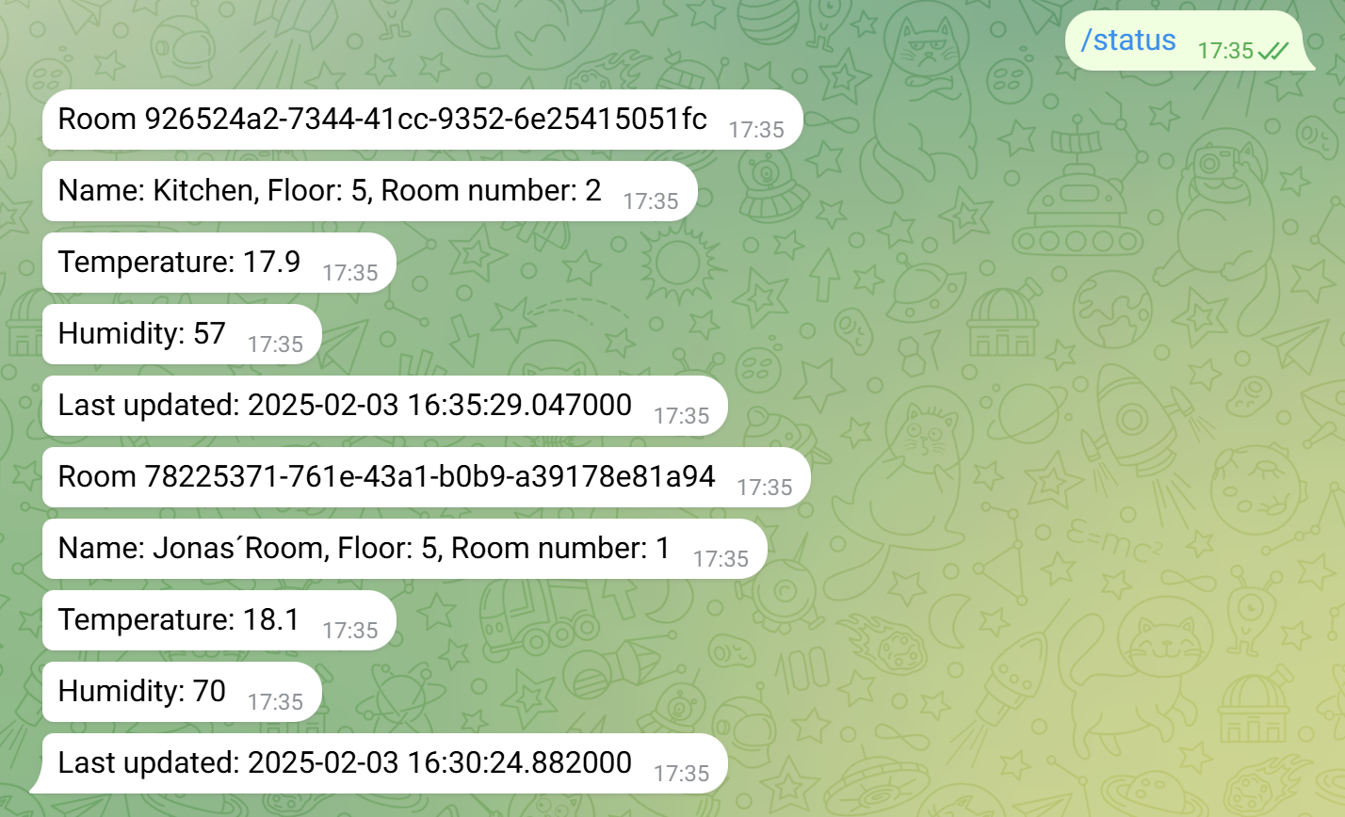
3. Design
Application Layer
Telegram APIs
Example using /status

Slide 20
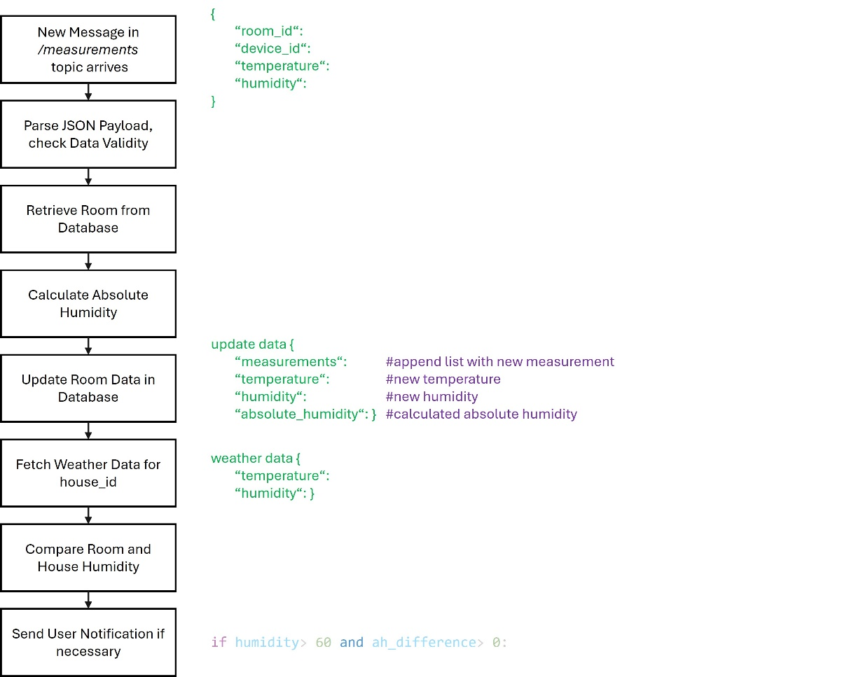
3. Design
Application Layer
MQTT Measurement Handler
Running on the Flask Server
Subsciber
handles incoming messages in the measurement topic

Slide 21
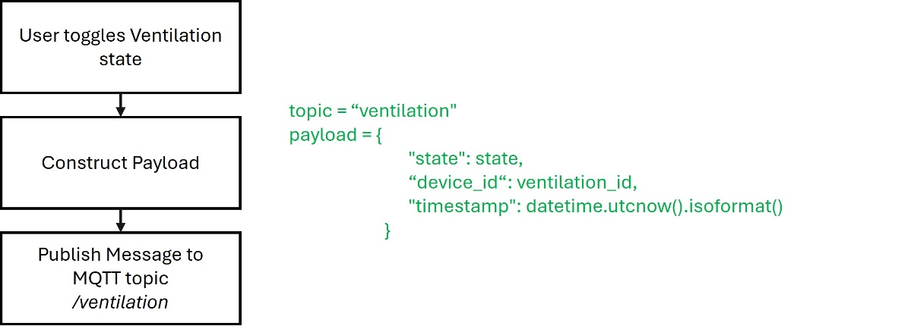
3. Design
Application Layer
MQTT Ventilation Handler
Running on the Flask Server
Publisher
sends messages to the ventilation topic

Slide 22
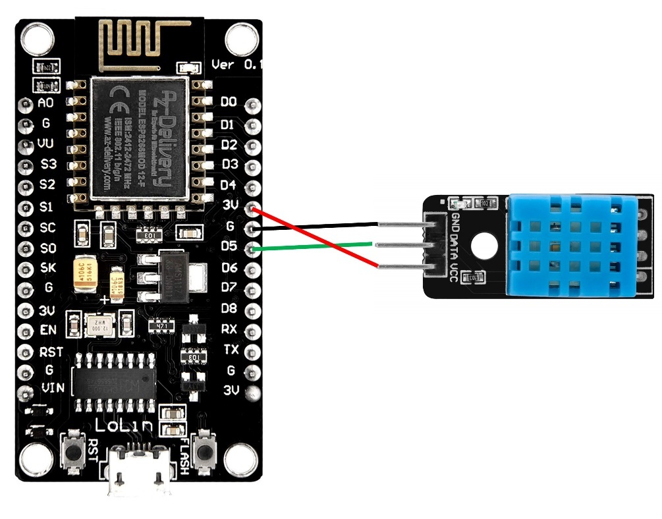
4. Prototype
Measurement Device
used DHT11 instead of the DHT22
setup of the mqtt broker was complicated
sends measured data to the measurement topic

Slide 23
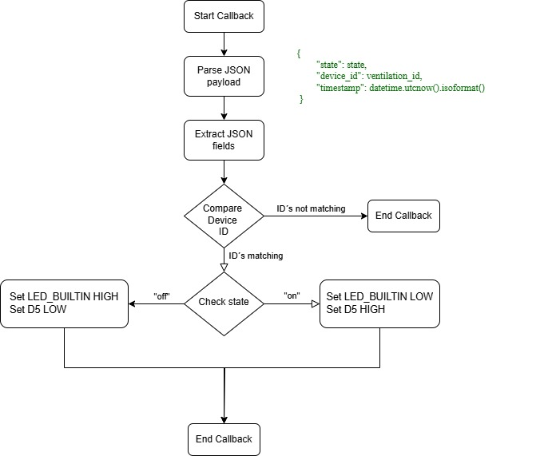
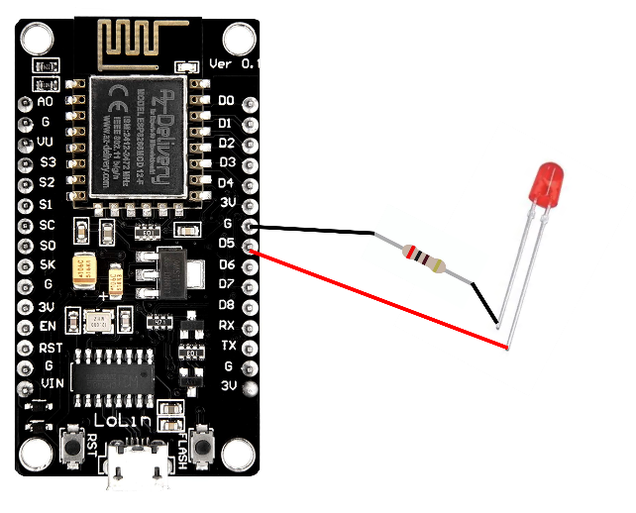
4. Prototype
Ventilation Device

Slide 24
5. Conclusion
ID | Requirement | Input | Output | Fulfilled
FR1 | Indoor Temperature and Humidity Monitoring | Current room temperature and humidity | System status update | yes
FR2 | Outdoor Temperature and Humidity Monitoring | Current outdoor temperature and humidity at a specific location | System status update | (yes)
FR3 | Absolute Humidity Calculation | Temperature and Relative Humidity | System status update | yes
FR4 | Compare Indoor and Outdoor Absolute Humidity | Absolute Humidity | System status update, Flag | yes
FR5 | User Notification to recommend when the window should be opened | Absolute Humidity Comparison | Notification to the user | yes
FR6 | User Warning for high indoor Relative Humidity | Indoor Relative Humidity | Alert notification to the user | yes
FR7 | Update Sensor Configuration | Sensor Configuration Data | Updated System | no
FR8 | Update Thresholds | User Input | Updated System | no
FR9 | User Registration | User data | Registered User | (yes)
FR10 | House Registration | House data | Updated System | (yes)
FR11 | Remote Window Opening | User command | Window opened, or ventilation system started | yes

Slide 25
Thanks a lot for your attention!
Questions?

